Slide 1
CONSUMER BEHAVIOR
Lecture 3

Slide 2
Learning Objectives
Know the major factors influencing consumer behavior
Know the stages in the buying behavior process

Slide 3



ORGANIZATION
1. Introduction
2. Cultural Factors
3. Social Factors
4. Personal Factors
5. Psychological Factors
6. Buying Decision Process

Slide 4
1. INTRODUCTION
Behavior of consumers in marketplace
purchase
use
evaluate
dispose of goods & services
Post-purchase phenomena
satisfaction
anxiety
complaint behavior

Slide 5
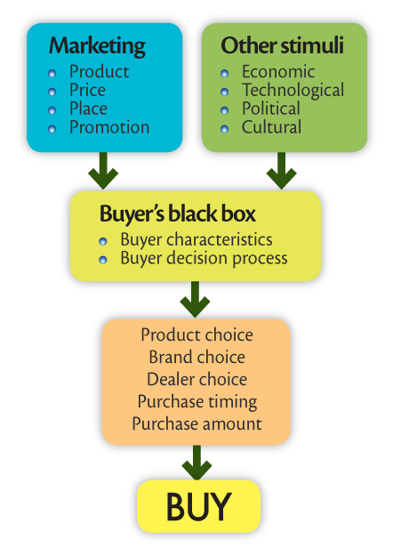
Model of Consumer Behavior

Slide 6
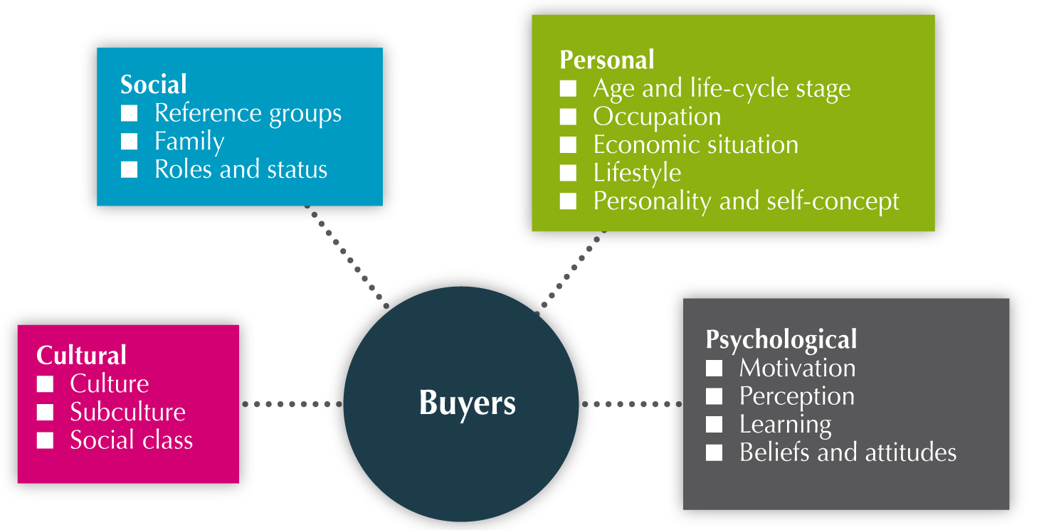
Factors Influencing Consumer Behavior

Slide 7

CULTURAL FACTORS
Set of learned beliefs, values, attitudes, habits, & behavior shared by members of a society & transmitted from generation to generation
Subculture

Slide 8
SOCIAL FACTORS
Normative Social Influence
Influence from others to conform to their expectations (e.g., “face”)
Informational Social Influence
Use others as sources of information
Sources
Family
Reference Groups

Slide 9
SOCIAL FACTORS - cont’d
Groups
Membership
Reference (opinion leaders)
Aspirational
Family
Most important consumer
buying organization
Roles &
Status
Role = Expected activities
Status = Esteem given to role
by society

Slide 10
SOCIAL FACTORS - cont’d
Word-of-mouth
Primarily informational
May be positive, neutral, or negative
Opinion Leaders
Knowledgeable & objective about particular area & to whom others consult in that area

Slide 11
PERSONAL FACTORS
1. Demographic
Age & Life Cycle Stage
Education
Economic Situation

Slide 12
Personal Factors – cont’d
Lifestyle
Pattern of Living as Expressed
in Psychographics
Activities
Interests
Opinions

Slide 13
2. Values and lifestyle targeting
PERSONAL FACTORS - cont’d
Activities | Interests | Opinions
Work | Job | About themselves
Hobbies | Home | Social issues
Social events | Family | Politics
Holiday | Community | Business
Entertainment | Fashion | Economics
Community | Food | Education
Sports | Media | Products
Shopping | Recreation | Culture
Club membership | Achievement | Future

Slide 14
PERSONAL FACTORS - cont’d
3. Personality & Self Concept
Personality: Distinguishing psychological characteristics leading to relatively consistent
& enduring responses to environment
Self Concept: Consumer’s perception of him/herself

Slide 15
PSYCHOLOGICAL FACTORS
1. Motivation
Sufficiently strong need directing consumer to fulfill it to reduce inner tension
Maslow’s Hierarchy of Needs
Physiological
Safety
Social
Esteem
Self-actualization

Slide 16
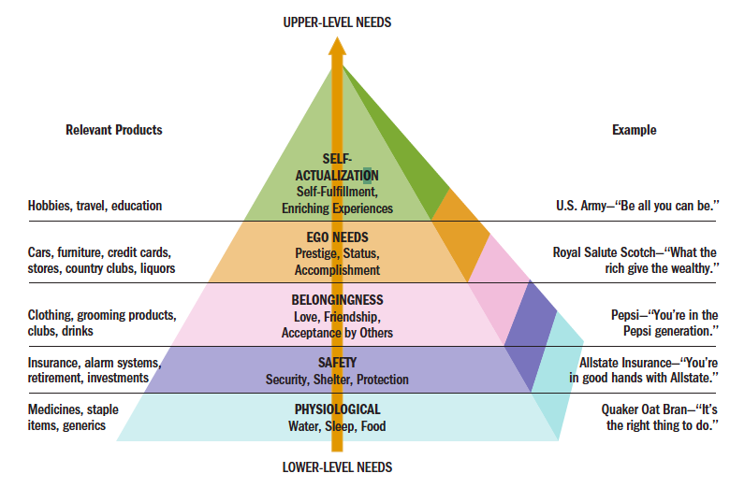
Maslow’s Hierarchy of Needs

Slide 17
PSYCHOLOGICAL FACTORS - cont’d
2. Perception
How consumer selects, organizes, & interprets information to create a meaningful picture of the world
Stimulus influences
* Colour * Size
* Contrast * Movement
* Intensity * Novelty
Subjective
Brand/Store Image

Slide 18
PSYCHOLOGICAL FACTORS - cont’d
3. Attitude
Enduring positive/negative feeling towards an object
Influenced by:
Own beliefs
Importance of belief
Important Others

Slide 19
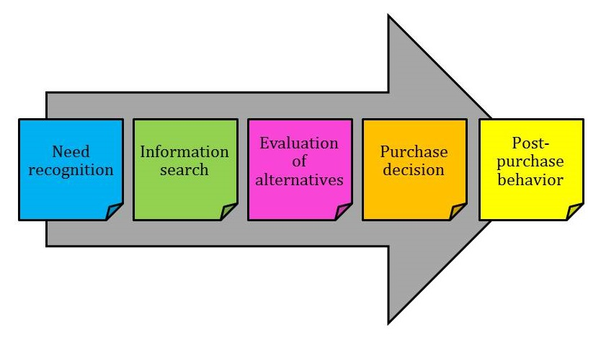
Linking Psychological Influences and Buying Decision Process
Motivation
Perception
Attitude

Slide 20
BUYING DECISION PROCESS
1. Need/Problem Recognition
Desired > Existing State
Marketing’s Role:
Identify & solve problems
Trigger recognition
Create problems by altering desired states
MOTIVATION

Slide 21
BUYING PROCESS - cont’d
PERCEPTION
2. Information Search
Internal if knowledgeable
External sources:
Personal (e.g., friends, neighbors, family)
Commercial (e.g., ads)
Public (e.g., Consumer Reports)
Experimental (e.g., handling the product)
3. Alternative Evaluation
Beliefs, feelings
ATTITUDE

Slide 22
BUYING PROCESS - cont’d
4. Purchase Decision
Attitudes of Others
Unexpected situations
5. Post-purchase
Consumption
Disposition
Satisfaction

Slide 23
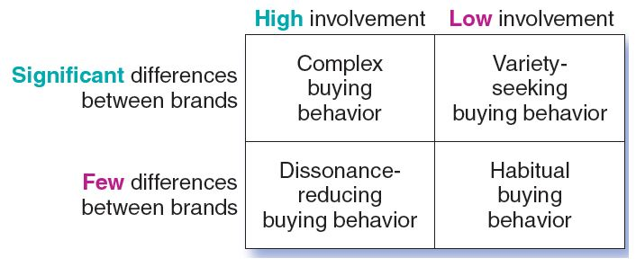
BUYING DECISION BEHAVIOR

